Slide 1
Functions/ CLasses
LO: IWBAT to use P5-JS to create multiple functions/classes within my programs.
Notes:
7-8.CT.8
Develop or remix a program that
effectively combines one or more control
structures for creative expression or to
solve a problem.

Slide 2
WARM UP:
Where have you seen functions before?
What functions have we already encountered?
Notes:
Have students write down replies, then discuss their answers and share out.

Slide 3
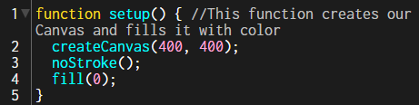
Functions
A JavaScript function is a block of code designed to perform a particular task.
A JavaScript function is executed when "something" invokes it (calls it).
A JavaScript function is defined with the function keyword, followed by a name, followed by parentheses ().
Function names can contain letters, digits, underscores, and dollar signs (same rules as variables).
The parentheses may include parameter names separated by commas:
(parameter1, parameter2, ...)
Notes:
https://www.w3schools.com/js/js_functions.asp

Slide 4
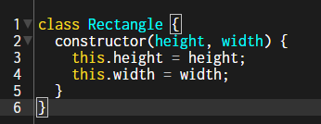
Classes
Classes are a template for creating objects. They encapsulate data with code to work on that data.
Classes are in fact "special functions", and just as you can define function expressions and function declarations, the class syntax has two components: class expressions and class declarations.
One way to define a class is using a class declaration. To declare a class, you use the class keyword with the name of the class ("Rectangle" here).
Notes:
https://www.w3schools.com/js/js_functions.asp

Slide 5
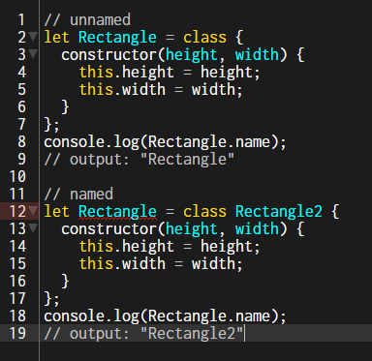
Classes
A class expression is another way to define a class. Class expressions can be named or unnamed. The name given to a named class expression is local to the class's body. However, it can be accessed via the name property.
Notes:
https://www.w3schools.com/js/js_functions.asp

Slide 6
Find the Functions and Classes
Work with a partner and look through the following program.
Look for instances where functions and classes were used.
Label what you think they each do in the program.
https://github.com/CodingTrain/website/blob/main/beginners/p5js/6.2-classes/P5/sketch.js
When done, name file “Functions” and run the program to compare your results.
Functions | Purpose | Class | Purpose
Notes:
Have the students run the program when done to check their solutions.

Slide 7
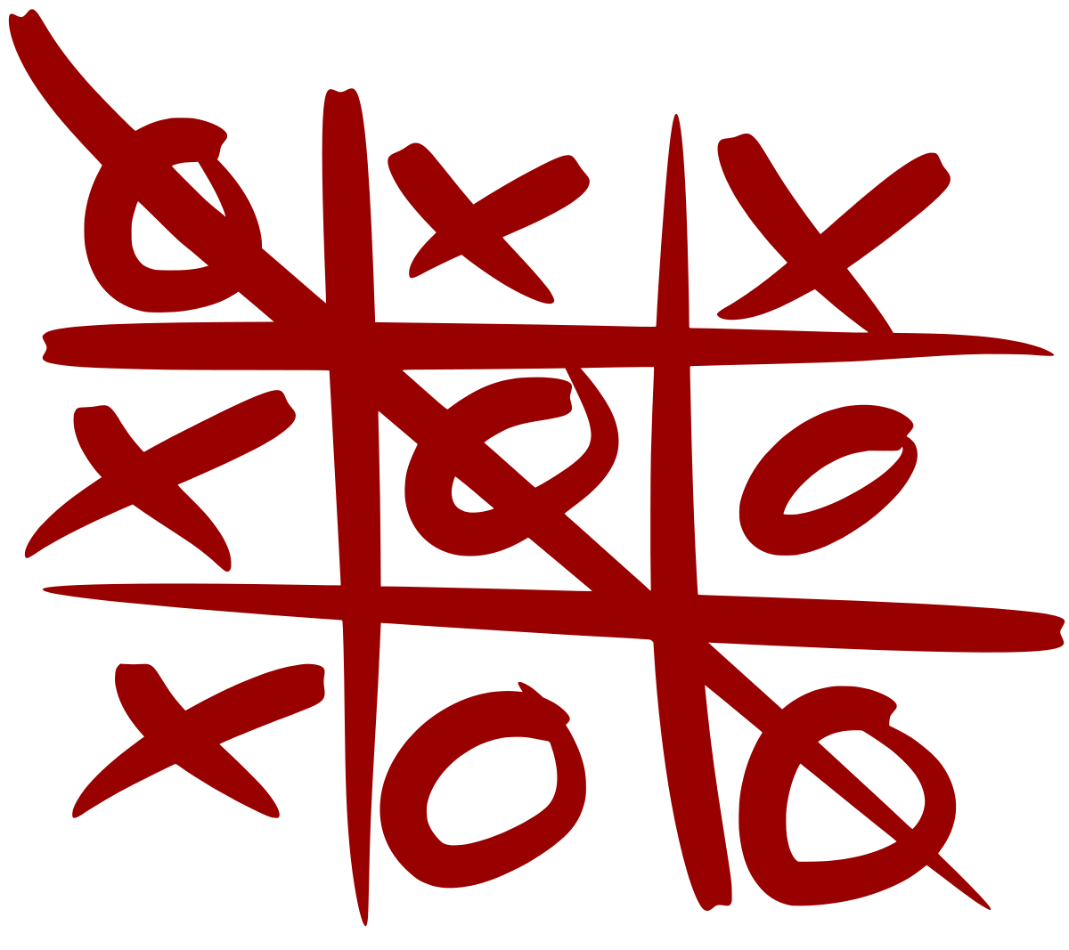
Activity
Using everything we’ve learned, create a very simple Tic-Tac-Toe game.
Needs to have:
Game board
When clicked, X or O shows
Functions and classes
Notes:
Walk around and check if anyone needs help
https://p5js.org/learn/interactivity.html

